Slide 1







Spatial Cognition
Towards computer vision systems that understand real world assembly processes

Slide 2
Introduction
Understanding Spatial Cognitions
Spatial cognition is the ability of an individual to perceive, understand, and navigate the physical space.
It is a complex process involving perception, memory and decision making.
It is essential to understand spatial cognition to develop better computational tools and processes.
Spatial cognition is a crucial aspect of various fields, including architecture, psychology, and neuroscience.
Notes:
Spatial cognition refers to the mental processes and abilities involved in perceiving, understanding, and navigating through the physical space around us. It encompasses the way we perceive, interpret, and mentally represent spatial information, such as the size, shape, distance, and location of objects and places in our environment.
Humans possess remarkable spatial cognition skills that allow us to interact effectively with the world. These skills are supported by various cognitive processes, including perception, attention, memory, and problem-solving.
Enhancing spatial cognition skills can have broad practical implications, ranging from improving navigation systems and architectural design to optimizing educational curricula and training programs. Additionally, spatial cognition training can benefit individuals of all ages by enhancing their cognitive abilities, problem-solving skills, and overall spatial awareness.

Slide 3
Recalling the Outcomes of Research Paper
Characterizing spatial construction processes: Toward computational tools to understand cognition
Notes:
Spatial cognition refers to the mental processes and abilities involved in perceiving, understanding, and navigating through the physical space around us. It encompasses the way we perceive, interpret, and mentally represent spatial information, such as the size, shape, distance, and location of objects and places in our environment.
Humans possess remarkable spatial cognition skills that allow us to interact effectively with the world. These skills are supported by various cognitive processes, including perception, attention, memory, and problem-solving.
Enhancing spatial cognition skills can have broad practical implications, ranging from improving navigation systems and architectural design to optimizing educational curricula and training programs. Additionally, spatial cognition training can benefit individuals of all ages by enhancing their cognitive abilities, problem-solving skills, and overall spatial awareness.

Slide 4

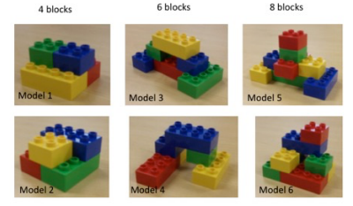


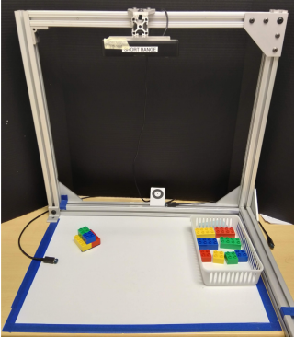

Procedure
Participants
27 healthy adults 18-53 years old (M = 21;4, SD = 6;6)
Materials
Duplo™ blocks were used for the construction copy task.
PrimeSense Carmine RGBD camera mounted in an overhead configuration to record participants.
Assigned Work
Participants were asked to copy six different block models of varying sizes, each consisting of 4,6, or 8 blocks
Notes:
Duplo™ blocks for the construction copy task. These blocks were chosen for several reasons. First, the attachment mechanism allowed the blocks to be connected to each other in fixed ways. The attachment studs permitted precise specification of the relationships between blocks above and beside one another. In addition, the limited set of colors (red, yellow, green, blue) of each shape (2x2 square, 4x2 rectangle) were ideal for the precise measurement system we developed.

Slide 5
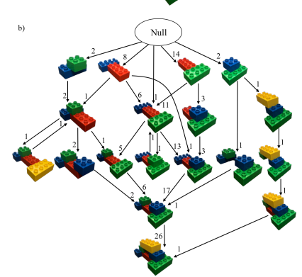
Result

Slide 6
Overview
In this paper, a method is being described for performing fine grained structural parsing of time series derived from spatial assemblies.
So the flow would be:
Seeing some related work.
Defining a representation for spatial assemblies and an action that modifies them.
Deriving a probabilistic model and inference algorithms for assembly processes.

Slide 7
Related Works
Notes:
I was two papers, one of which was for charachterizing Spatial construction process and other was a computer vision approach for understanding these assembly processes.

Slide 8
Action Recognition from procedural data
Fine-grained action recognition tasks often involve procedural data, where an agent tries to change the state of an entity to achieve a desired outcome.
A recent paper in the natural language processing field uses procedural text data (recipes) to predict state changes caused by actions.
The approach focuses on parsing state changes over time while also implicitly addressing action recognition in the model.

Slide 9
Fine-grained inference in computer vision
Recent trends in computer vision and action recognition involve estimating more complex and structured variables, as performance on traditional classification tasks has reached saturation.
In action recognition, there are models that utilize spatio-temporal graphs to represent human-object interactions, although the descriptions are relatively coarse.
Some recent work in computer vision focuses on parsing semantic graphs from images, aiming to identify objects, localize them, and estimate relationships between pairs of objects.
Some recent work in computer vision focuses on parsing semantic graphs from images, aiming to identify objects, localize them, and estimate relationships between pairs of objects.
Notes:
Our application adds a level of detail beyond these traditional adjacency relationships: in addition to describing which two objects are connected, we also describe precisely how they are connected by specifying the exact 3D pose (rotation and translation) between the two objects.

Slide 10
Representation of Assembly Process
Notes:
I was two papers, one of which was for charachterizing Spatial construction process and other was a computer vision approach for understanding these assembly processes.

Slide 11
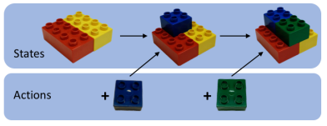
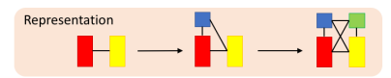
Representations
State is a graph
Vertices(V) are blocks
Edges(E) are block connections
Edges are labelled with a block’s relative pose in coordinate frame of its neighbour

Slide 12


Action Representation
Each person are given a set of blocks and a model to copy
Each action captured the start and end time of a change made to the copy as it was being constructed.
There are 2 types of actions:
Connect takes a state, two object and a relative pose.
Disconnect takes a state and two objects as arguments.
To accomplish the state change, we have to do 3 precise decisions
Choose a correct block
Connect to the right block in the previous state.
Finally add this block to right pose.

Slide 13
Probabilistic Graphical Model
Notes:
I was two papers, one of which was for charachterizing Spatial construction process and other was a computer vision approach for understanding these assembly processes.

Slide 14
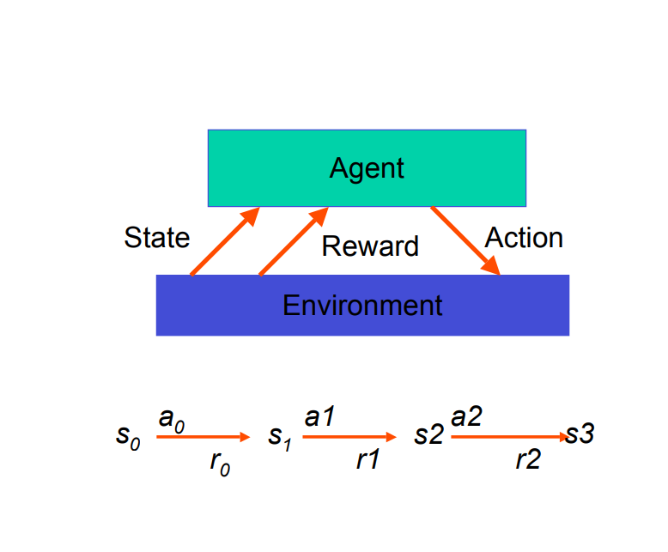
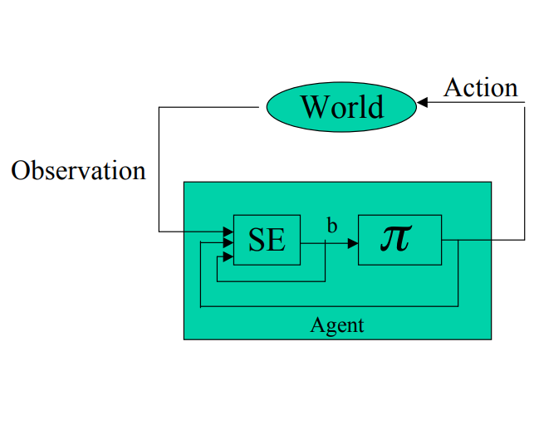
Model Definition
The model is based on time series structure inspired by a partially-observable Markov decision process(POMDP).
Used to estimate the states from a sequence of video keyframes
POMDP stands for Partially Observable Markov Decision Process. It is a mathematical framework used to model decision-making problems in situations where the agent does not have full knowledge of the state of the environment. In a POMDP, the environment is represented as a Markov Decision Process (MDP), but the agent only has partial observations or noisy measurements of the environment state.

Slide 15
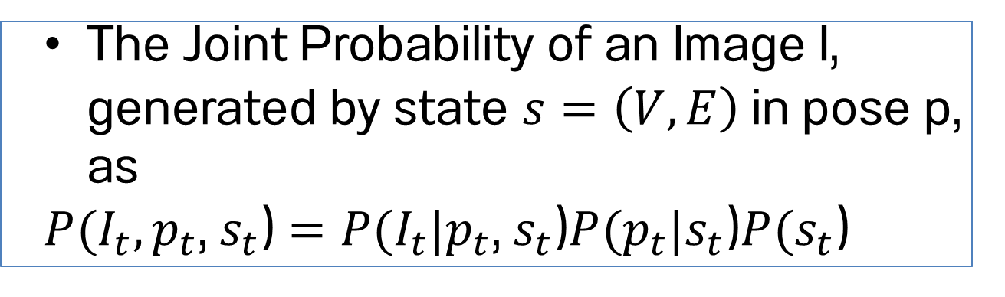
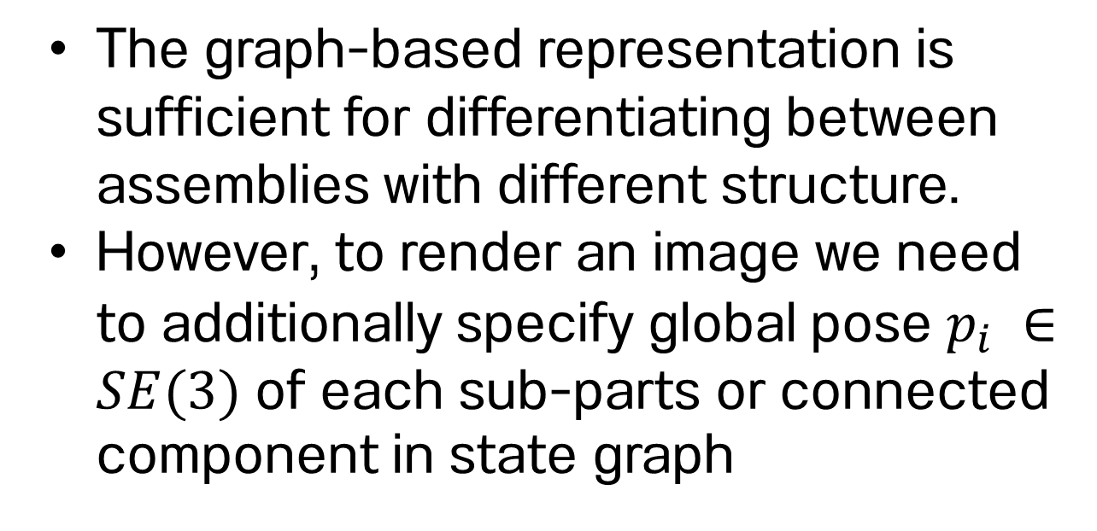
Observation Model
The graph-based representation is sufficient for differentiating between assemblies with different structure.
However, to render an image we need to additionally specify global pose $p_{i} ∈SE(3)$ of each sub-parts or connected component in state graph
If we have an appearance and a shape for each object, and the camera parameters are known, we can generate a template T by rendering each sub-part using the poses in p.
Disconnected sub-parts may be rendered independently if we ignore collisions and occlusions
The Joint Probability of an Image I, generated by state $s=\left(V,E\right)$in pose p, as
$P(I_{t},p_{t}$, $s_{t}$) $=P(I_{t}|p_{t}\text{,} s_{t}\text{)}P(p_{t}\text{|}s_{t}\text{)}P(s_{t}\text{)}$

Slide 16
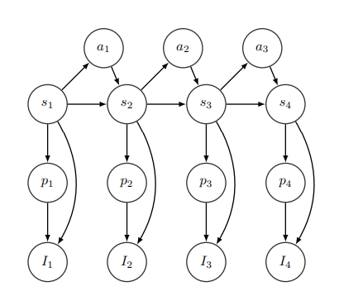
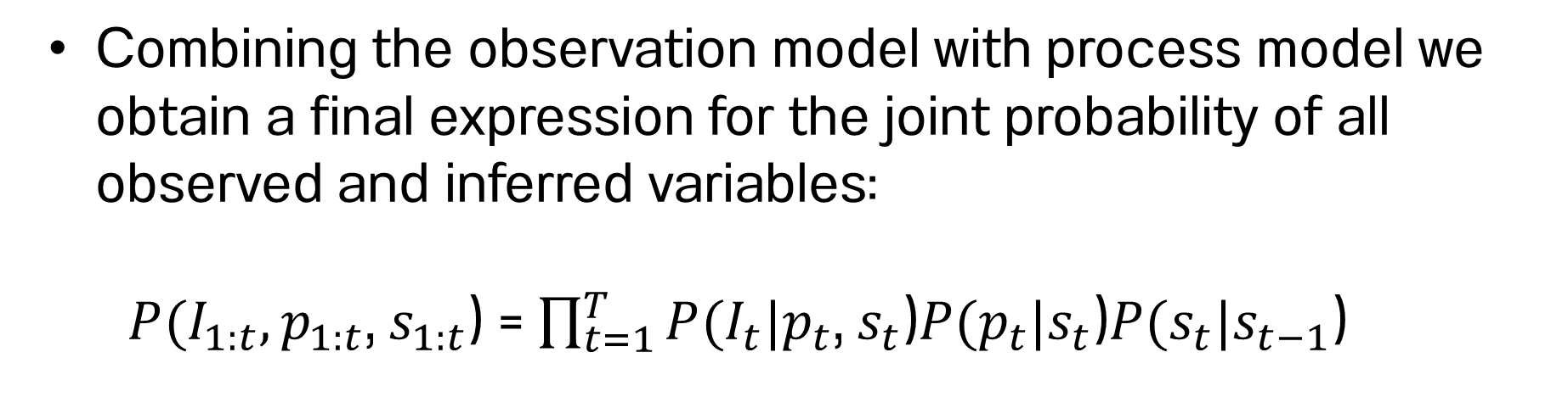
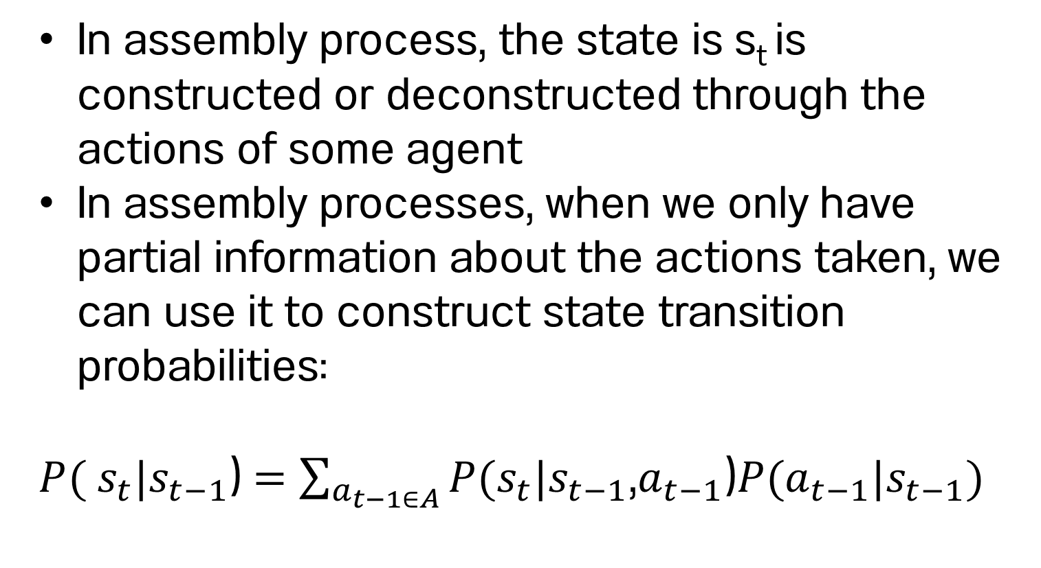
Process Model
In assembly process, the state is s_{t} is constructed or deconstructed through the actions of some agent
In assembly processes, when we only have partial information about the actions taken, we can use it to construct state transition probabilities:
$P($ $s_{t}|s_{t−1}$) $=\sum_{a_{t−1∈A}}{P(s_{t}|s_{t−1}\text{,}a_{t−1}\text{)}P(a_{t−1}\text{|}s_{t−1}\text{)}}$
Combining the observation model with process model we obtain a final expression for the joint probability of all observed and inferred variables:
$P(I_{1:t},p_{1:t}$, $s_{1:t}$) = $\prod_{t=1}^{T}{P(I_{t}|p_{t}\text{,} s_{t}\text{)}P(p_{t}\text{|}s_{t}\text{)}P(s_{t}\text{|}s_{t−1}\text{) }}$
S_{t} = state of block model
p_{t} = pose of block model
I_{t} = Video keyframe
A_{t} = Action

Slide 17
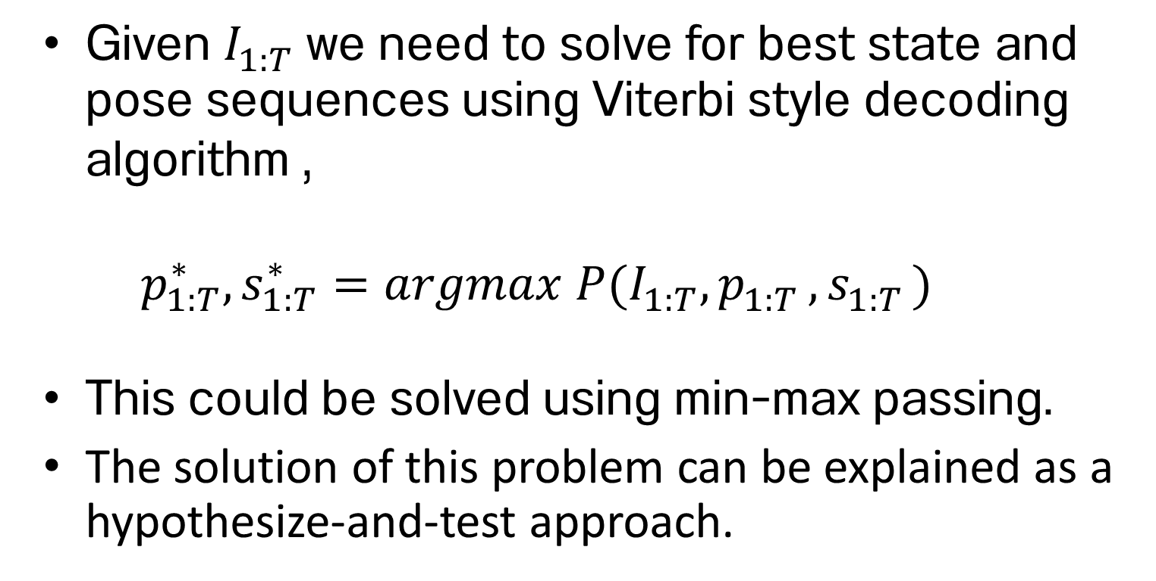
Inference
Given $I_{1:T}^{}$we need to solve for best state and pose sequences using Viterbi style decoding algorithm ,
$$p_{1:T}^{∗},s_{1:T}^{∗}=argmax P(I_{1:T}^{}{,p}_{1:T}^{}{,s}_{1:T}^{})$$
This could be solved using min-max passing.
The solution of this problem can be explained as a hypothesize-and-test approach.
S_{t} = state of block model
p_{t} = pose of block model
I_{t} = Video keyframe
A_{t} = Action

Slide 18
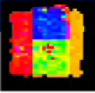
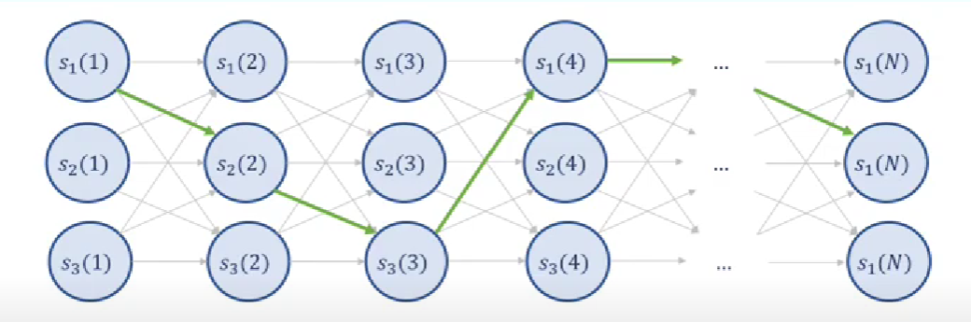
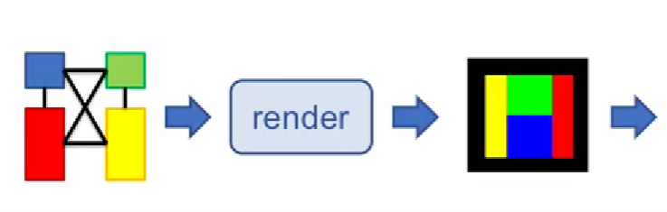

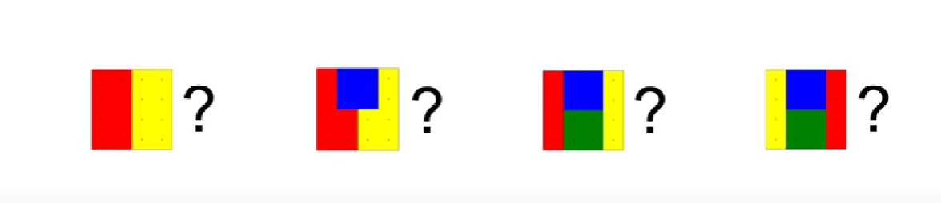
The solution of the problem can be explained as a hypothesize-and-test approach in 3 steps:
Hypothesis Generation
Test Hypothesis locally (render & register template)
Decode best state sequence globally
Notes:
For each image we generate a set of hypothesis state.
Then we test each hypothesis by rendering a template and registering it to the image
And finally we use Viterbi decoding algorithm to compute the best hypothesis sequences for the images observed.

Slide 19
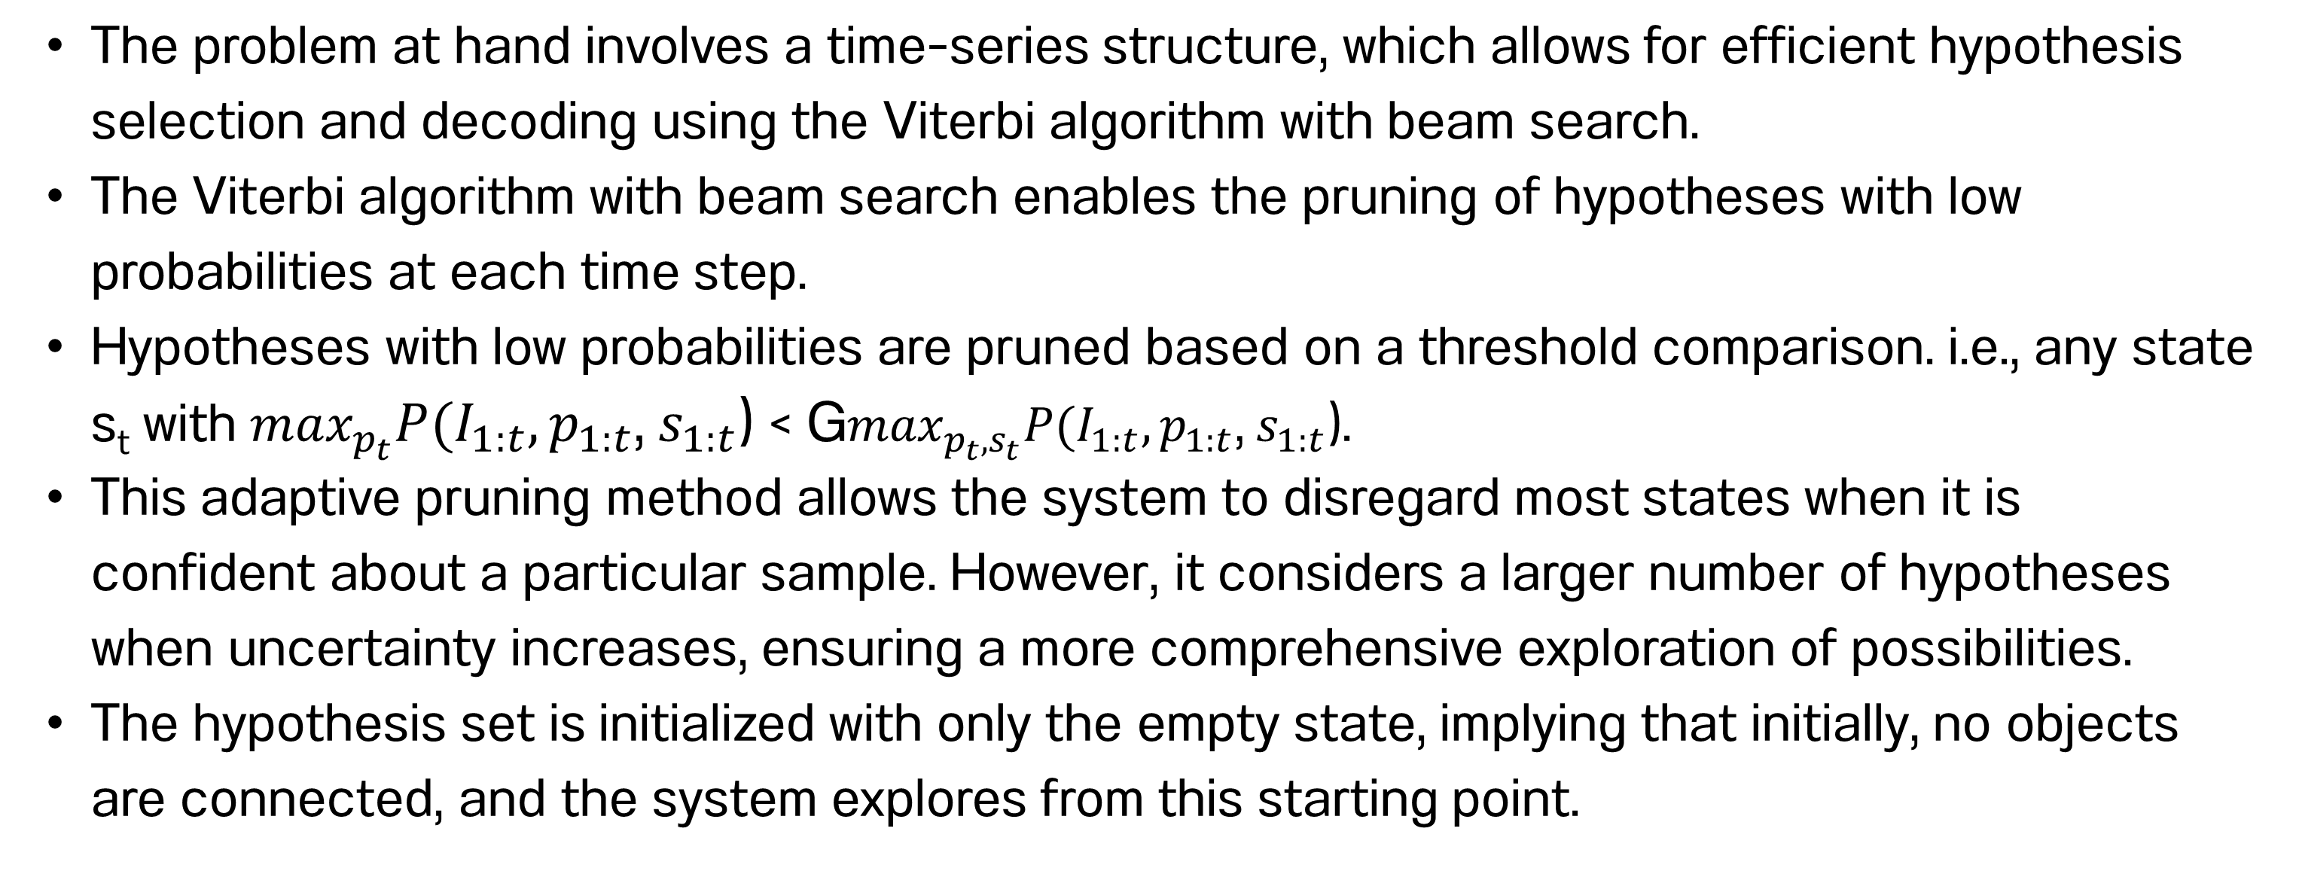
Hypothesis Generation
The problem at hand involves a time-series structure, which allows for efficient hypothesis selection and decoding using the Viterbi algorithm with beam search.
The Viterbi algorithm with beam search enables the pruning of hypotheses with low probabilities at each time step.
Hypotheses with low probabilities are pruned based on a threshold comparison. i.e., any state s_{t} with $\max_{p_{t}}P(I_{1:t},p_{1:t}\text{,} s_{1:t}\text{)}\text{ < }\text{G}\max_{p_{t}, s_{t}}P(I_{1:t},p_{1:t}\text{,} s_{1:t}\text{)}$.
This adaptive pruning method allows the system to disregard most states when it is confident about a particular sample. However, it considers a larger number of hypotheses when uncertainty increases, ensuring a more comprehensive exploration of possibilities.
The hypothesis set is initialized with only the empty state, implying that initially, no objects are connected, and the system explores from this starting point.
Notes:
Spatial construction—creating or copying spatial arrangements—is a hallmark of human spatial cognition. Spatial construction appears early in development, predicts later spatial and mathematical skills, and is used throughout life.
In this paper they introduce a novel behavioral coding formalism to characterize an individual’s entire construction process, examine many individuals’ processes in aggregate, and summarize patterns that emerge.
offers a new method that can more precisely describe the behavioral patterns observed during construction in order to reveal the underlying cognitive processes engaged, and capture individual differences in building expertise

Slide 20
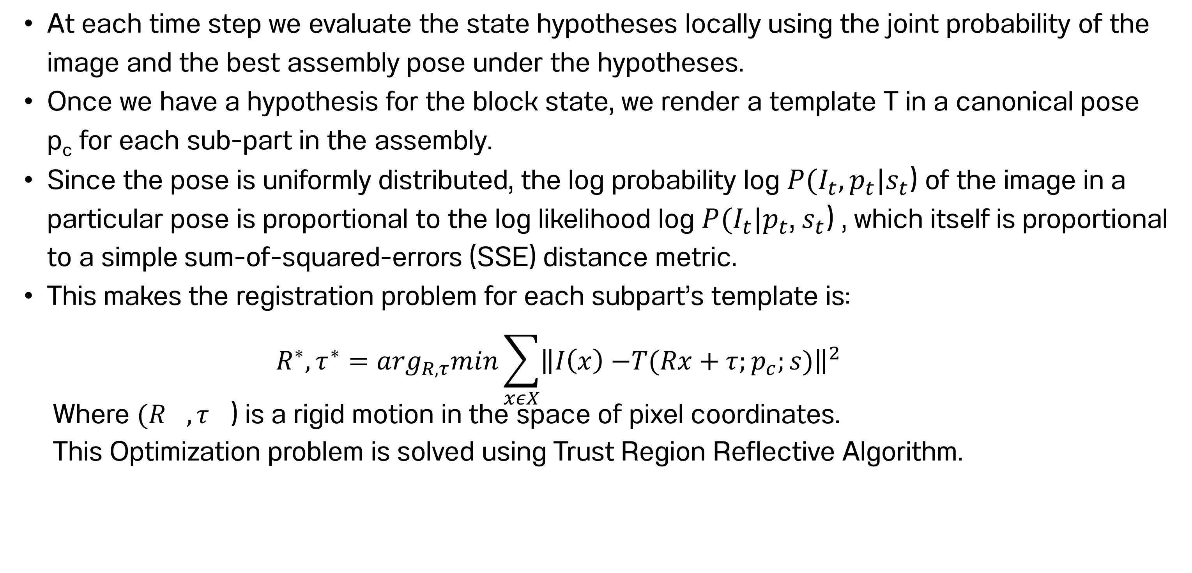
Template Registration
At each time step we evaluate the state hypotheses locally using the joint probability of the image and the best assembly pose under the hypotheses.
Once we have a hypothesis for the block state, we render a template T in a canonical pose p_{c} for each sub-part in the assembly.
Since the pose is uniformly distributed, the log probability log $P(I_{t},p_{t}|s_{t}$) of the image in a particular pose is proportional to the log likelihood log $P(I_{t}|p_{t}$, $s_{t}$) , which itself is proportional to a simple sum-of-squared-errors (SSE) distance metric.
This makes the registration problem for each subpart’s template is:
$$R^{∗},τ^{∗}=\arg_{R,τ}min\sum_{xεX}{{\left\|I\left(x\right)−\right.\left.T(Rx+τ;p_{c};s)\right\|}^{2}}$$
Where $(R^{},τ^{}$) is a rigid motion in the space of pixel coordinates.
This Optimization problem is solved using Trust Region Reflective Algorithm.
Notes:
Spatial construction—creating or copying spatial arrangements—is a hallmark of human spatial cognition. Spatial construction appears early in development, predicts later spatial and mathematical skills, and is used throughout life.
In this paper they introduce a novel behavioral coding formalism to characterize an individual’s entire construction process, examine many individuals’ processes in aggregate, and summarize patterns that emerge.
offers a new method that can more precisely describe the behavioral patterns observed during construction in order to reveal the underlying cognitive processes engaged, and capture individual differences in building expertise

Slide 21
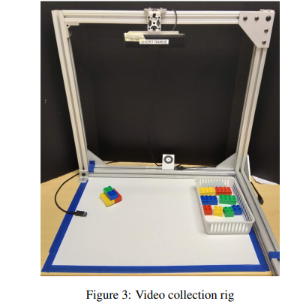
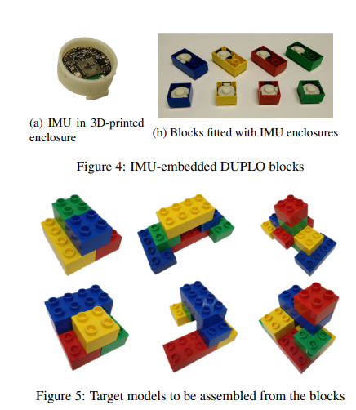
Parsing Block Construction Process
All the procedure discussed are used to parse the videos of DUPLO block building activities.
These data were recorded during behavioral experiments studying early childhood
Notes:
We evaluate performance at three increasingly detailed levels of spatial granularity on two multimodal (RGBD + IMU) datasets. On the first, designed to match the assumptions of the model, we report better than 90% accuracy at the finest level of granularity. On the second, designed to test the robustness of our model under adverse, real-world conditions, we report 67% accuracy and 91% precision at the mid-level of granularity.

Slide 22
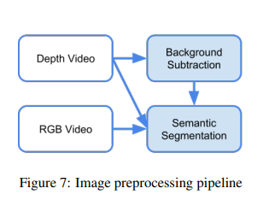
Image Preprocessing
Background Subtraction
A plane is fitted to the depth image, allowing for the identification of the background region.
Pixels within a certain distance from the fitted plane are masked out, effectively removing the background from the image.
Semantic Segmentation
Semantic segmentation is necessary due to the presence of hands and other objects in the frame that can confound the analysis.
Pixel Level Classification :
To address the effects of partial occlusions, a classifier is needed to determine whether pixels belong to blocks or hands in the foreground of an image. Two classes are defined: c0 for block pixels and c1 for hand pixels. A proxy dataset is constructed by combining keyframes assumed to be without hands and images from a child's play dataset assumed to contain some portion of a hand.
Segment level Classification:
Frames are segmented into super pixels. Then Segments larger than a threshold are assigned to the background class to avoid detecting obviously incorrect objects. Contiguous pixels assigned to the same class are grouped, resulting in a set of segments that are used as object proposals.
Notes:
Spatial construction—creating or copying spatial arrangements—is a hallmark of human spatial cognition. Spatial construction appears early in development, predicts later spatial and mathematical skills, and is used throughout life.
In this paper they introduce a novel behavioral coding formalism to characterize an individual’s entire construction process, examine many individuals’ processes in aggregate, and summarize patterns that emerge.
offers a new method that can more precisely describe the behavioral patterns observed during construction in order to reveal the underlying cognitive processes engaged, and capture individual differences in building expertise

Slide 23
Evaluation
The Evaluation of the model is done on two datasets
To assess the validity of our basic modelling assumption we use the controlled dataset, which has a clear view of every state
To assess the robustness of the system in a real world setting, we tested on the child play dataset.
Since it was collected in a less controlled environment, it features complications such as occlusions, distractions, and few state changes.

Slide 24
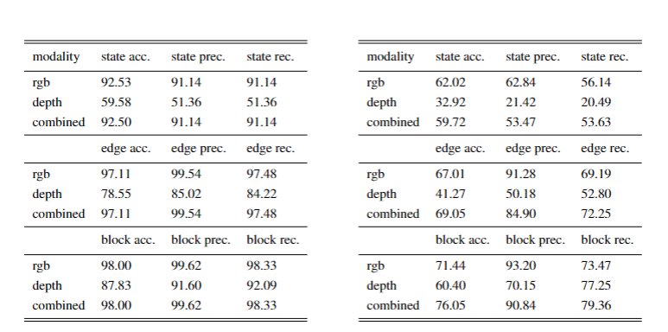

Slide 25

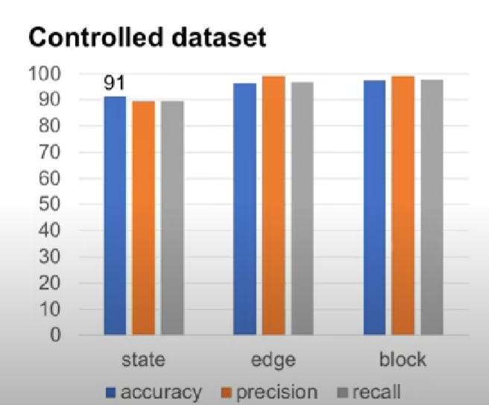
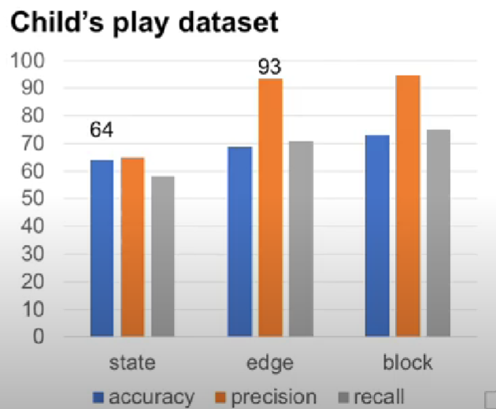


Notes:
In controlled dataset the system estimates more than 90% but it drops 64% in estimating the states but precision is 93% when estimating the edges. This tells us that when the system makes the mistake its guess is mostly true to subpart of the true state.

Slide 26
Conclusion

Slide 27
The paper presents a model for assembly processes and proposes a probabilistic inference algorithm.
The model is applied to parsing a block construction task and evaluated on two datasets: one controlled and one consisting of unconstrained data from child behavioral experiments.
The system performs exceptionally well when data conditions align with the modeling assumptions and still produces sensible results under more challenging data conditions.
The findings suggest new research opportunities in fine-grained action recognition and occlusion-robust computer vision.
The results depend on manually identified keyframes per state, but future work can explore reconstructing the model image using information from multiple consecutive frames and reducing reliance on manual keyframe extraction for autonomous systems.
The datasets multiple modalities offer the potential for exploring RGBD + IMU data fusion techniques.
IMU signals can be used as input for the action recognition system or to improve template registration by deriving orientation estimates from the IMU signals.
Notes:
In controlled dataset the system estimates more than 90% but it drops 64% in estimating the states but precision is 93% when estimating the edges. This tells us that when the system makes the mistake its guess is mostly true to subpart of the true state.

